Slide 1
Index Terms: Audio-Visual Speech Separation, Selective Attention, Multi-Scale Fusion, Brain-Inspired Architecture, Cocktail Party Effect
Citations: 44
IIANet: An Intra- and Inter-Modality Attention Network for Audio-Visual Speech Separation
Kai Li¹ Runxuan Yang¹ Fuchun Sun¹ Xiaolin Hu^{1, 2, 3}
¹ Department of Computer Science and Technology, Tsinghua University, Beijing, China
² Tsinghua Laboratory of Brain and Intelligence (THBI), Tsinghua University
³ IDG/McGovern Institute for Brain Research, Tsinghua University
arXiv: 2308.08143v3 [cs.SD] 2 Feb 2024
International Conference on Machine Learning (ICML), 2024
Code: https://github.com/JusperLee/IIANet
01/21

Slide 2
Introduction: The Cocktail Party Problem
Task Definition
Isolate one voice among many speakers.
AOSS (Audio-Only Speech Separation)
  Separation quality collapses under severe noise and reverberation.
AVSS (Audio-Visual Speech Separation)
  Lip motion provides a reliable, speaker-specific visual anchor.
Practical Applications
Useful for hearing aids, wearable devices, and speech recognition.
02/21

Slide 3
Introduction: Research Gaps
Existing Paradigms
CNNs offer low complexity but fuse at a single temporal scale.
Transformers use heavy similarity matrices, not designed for speaker selection.
Gap 1: Single Temporal Scale
Human brain integrates signals at multiple temporal levels.
Existing AVSS models ignore crucial cross-scale semantic relations.
Gap 2: No Selective Attention
Intra-modal top-down selective attention is entirely overlooked.
03/21

Slide 4
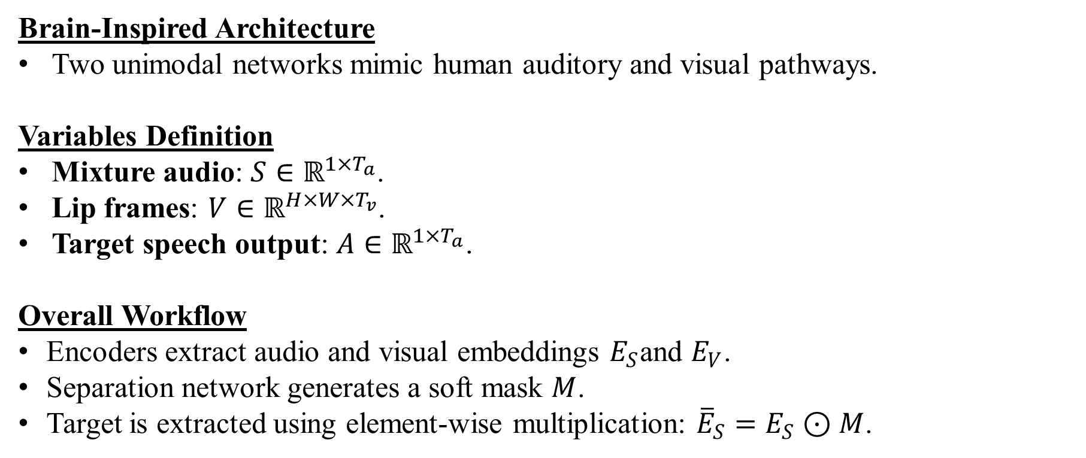
Introduction: The Proposed IIANet
Brain-Inspired Architecture
Two unimodal networks mimic human auditory and visual pathways.
Variables Definition
Mixture audio: $S∈ℝ^{1×T_{a}}$.
Lip frames: $V∈ℝ^{H×W×T_{v}}$.
Target speech output: $A∈ℝ^{1×T_{a}}$.
Overall Workflow
Encoders extract audio and visual embeddings $E_{S}$and $E_{V}$.
Separation network generates a soft mask $M$.
Target is extracted using element-wise multiplication: ${\overline{E}}_{S}=E_{S}⊙M$.
04/21

Slide 5
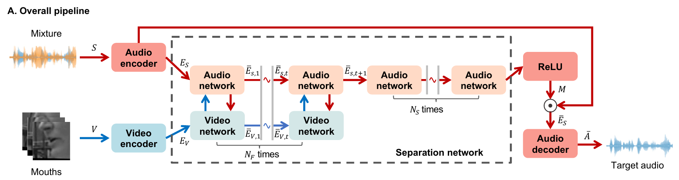
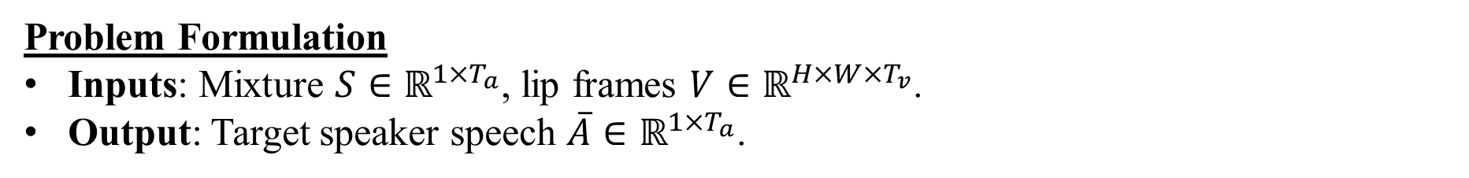
Methodology: Overall Pipeline
Problem Formulation
Inputs: Mixture $S∈ℝ^{1×T_{a}}$, lip frames $V∈ℝ^{H×W×T_{v}}$.
Output: Target speaker speech $\overline{A}∈ℝ^{1×T_{a}}$.
Caption: Fig. 1(A) Li et al. (2024). Overall pipeline of IIANet.
05/21

Slide 6
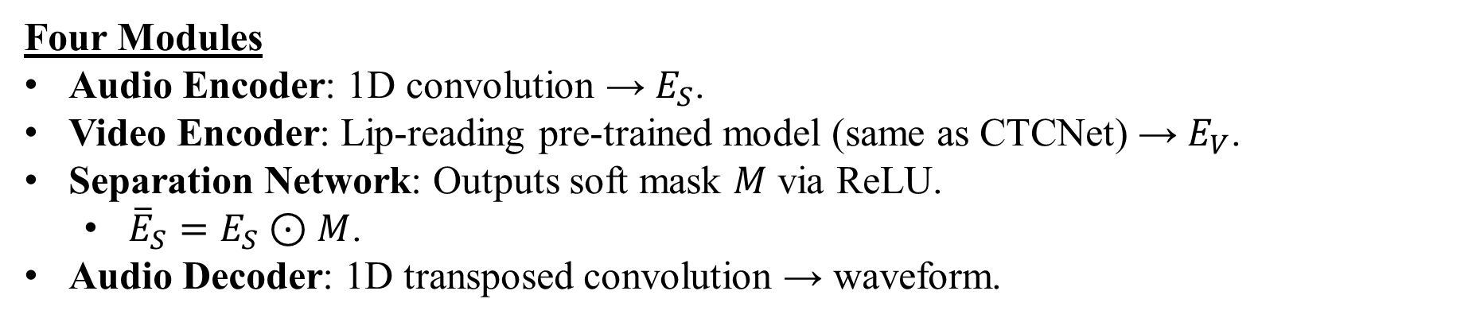
Methodology: Overall Pipeline
Four Modules
Audio Encoder: 1D convolution → $E_{S}$.
Video Encoder: Lip-reading pre-trained model (same as CTCNet) → $E_{V}$.
Separation Network: Outputs soft mask $M$ via ReLU.
  ${\overline{E}}_{S}=E_{S}⊙M$.
Audio Decoder: 1D transposed convolution → waveform.
Caption: Fig. 1(A) Li et al. (2024). Overall pipeline of IIANet.
06/21

Slide 7
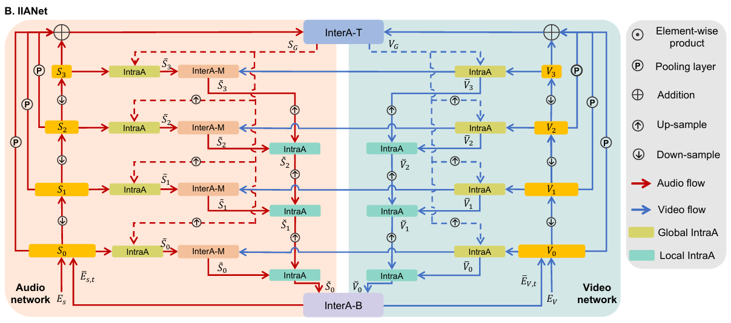
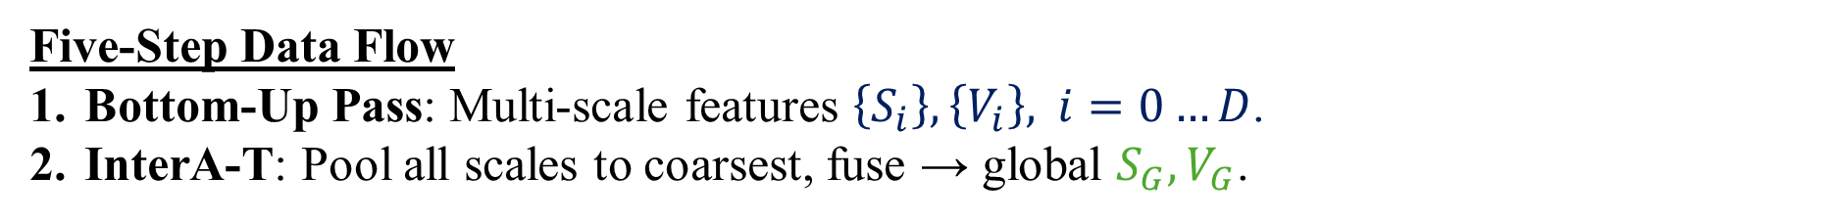
Methodology: Separation Network Workflow
Five-Step Data Flow
Bottom-Up Pass: Multi-scale features $\left\{S_{i}\right\},\left\{V_{i}\right\}, i=0…D$.
InterA-T: Pool all scales to coarsest, fuse → global $S_{G},V_{G}$.
Caption: Fig. 1(B) Li et al. (2024). The separation network of IIANet.
07/21

Slide 8
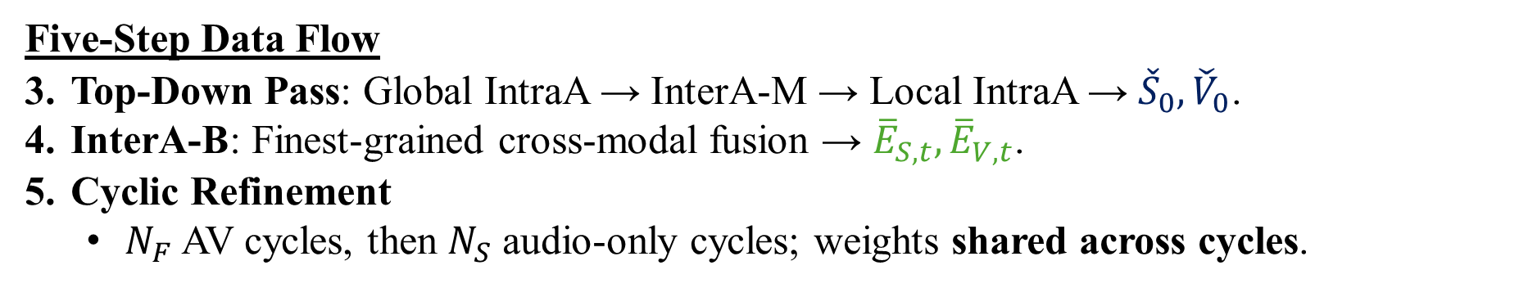
Methodology: Separation Network Workflow
Five-Step Data Flow
Top-Down Pass: Global IntraA → InterA-M → Local IntraA → ${\check{S}}_{0},{\check{V}}_{0}$.
InterA-B: Finest-grained cross-modal fusion → ${\overline{E}}_{S,t},{\overline{E}}_{V,t}$.
Cyclic Refinement
  $N_{F}$ AV cycles, then $N_{S}$ audio-only cycles; weights shared across cycles.
Caption: Fig. 1(B) Li et al. (2024). The separation network of IIANet.
08/21

Slide 9
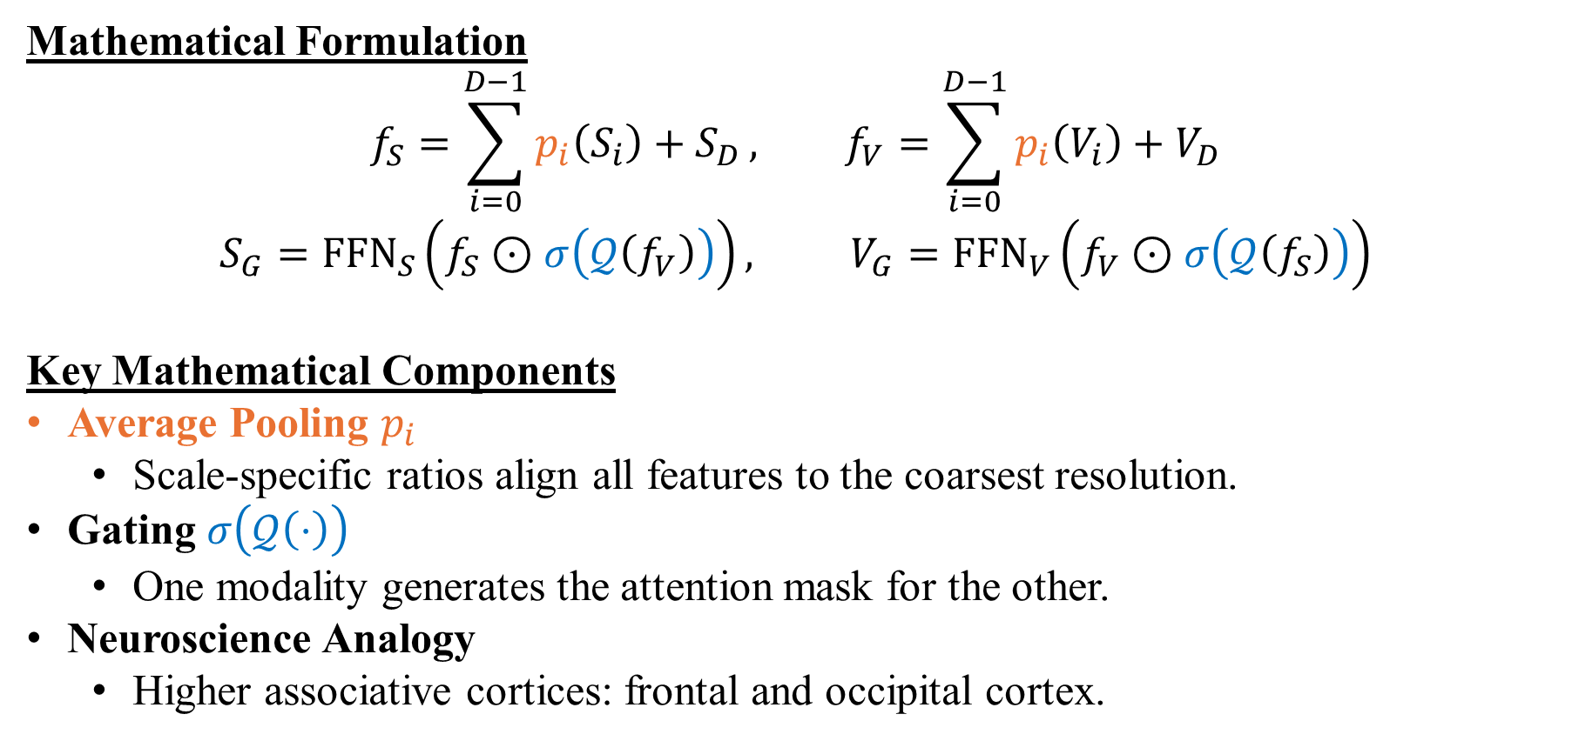
Methodology: InterA-T (Top Level)
Mathematical Formulation
$$f_{S}=\sum_{i=0}^{D−1}{p_{i}\left(S_{i}\right)+S_{D}}, f_{V}=\sum_{i=0}^{D−1}{p_{i}\left(V_{i}\right)+V_{D}}$$
$$S_{G}={\text{FFN}}_{S}\left(f_{S}⊙σ\left(𝒬\left(f_{V}\right)\right)\right), V_{G}={FFN}_{V}\left(f_{V}⊙σ\left(𝒬\left(f_{S}\right)\right)\right)$$
Key Mathematical Components
Average Pooling $p_{i}$
  Scale-specific ratios align all features to the coarsest resolution.
Gating $σ\left(𝒬\left(⋅\right)\right)$
  One modality generates the attention mask for the other.
Neuroscience Analogy
  Higher associative cortices: frontal and occipital cortex.
09/21

Slide 10
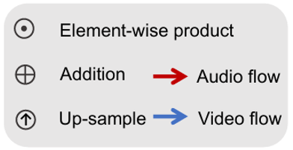
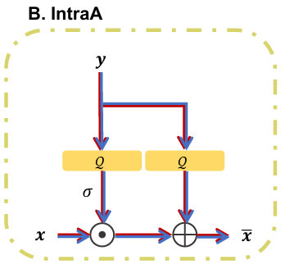
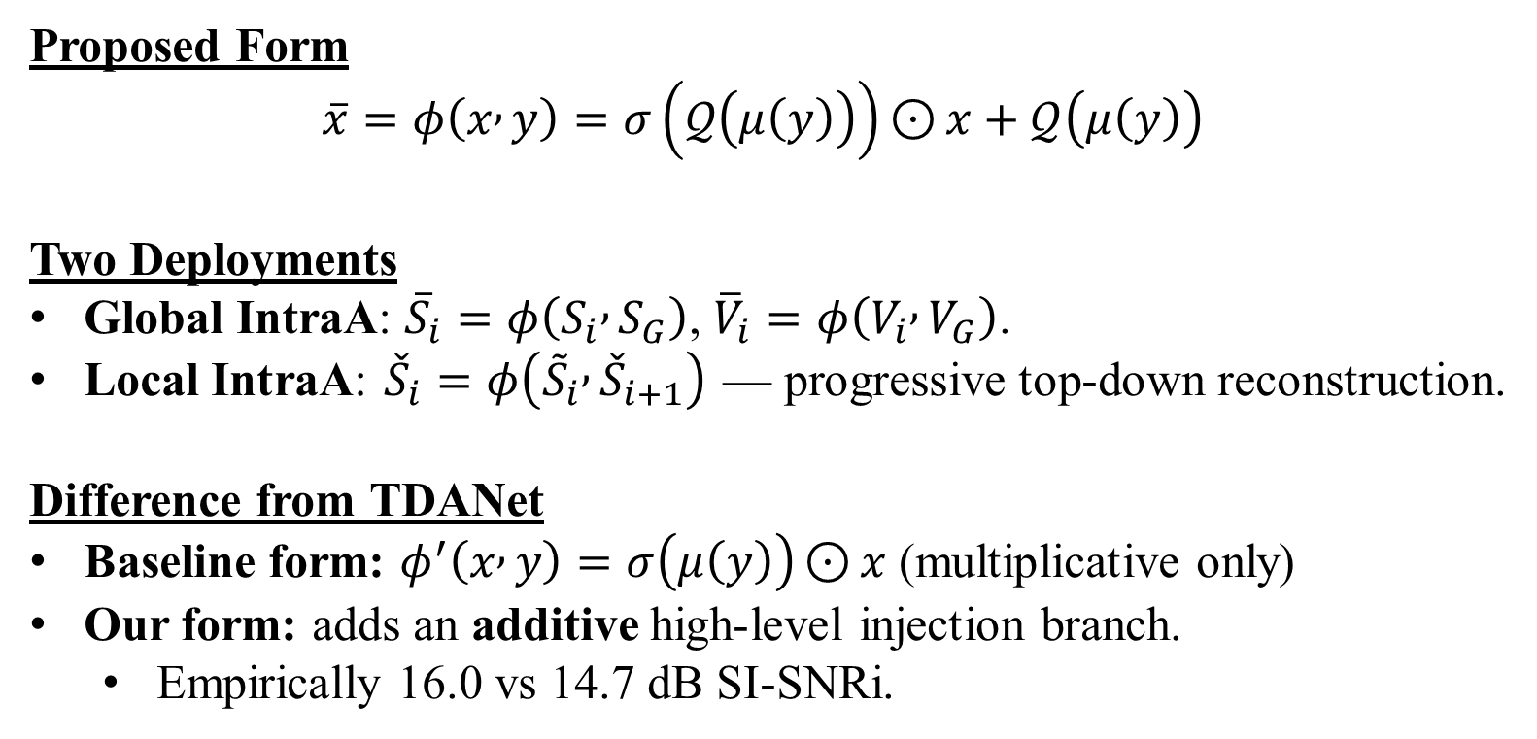
Methodology: IntraA (Top-Down Attention)
Proposed Form
$$\overline{x}=φ\left(x , y\right)=σ\left(𝒬\left(μ\left(y\right)\right)\right)⊙{x}+𝒬\left(μ\left(y\right)\right)$$
Two Deployments
Global IntraA: ${\overline{S}}_{i}=φ\left(S_{i} , S_{G}\right)$, ${\overline{V}}_{i}=φ\left(V_{i} , V_{G}\right)$.
Local IntraA: ${\check{S}}_{i}=φ\left({\tilde{S}}_{i} , {\check{S}}_{i+1}\right)$ — progressive top-down reconstruction.
Difference from TDANet
Baseline form: $φ^{′}\left(x , y\right)=σ\left(μ\left(y\right)\right)⊙{x}$ (multiplicative only)
Our form: adds an additive high-level injection branch.
  Empirically 16.0 vs 14.7 dB SI-SNRi.
Caption: Fig. 2(B) Li et al. (2024). IntraA block flow diagram.
10/21

Slide 11
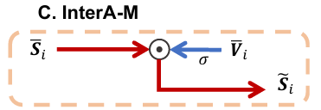
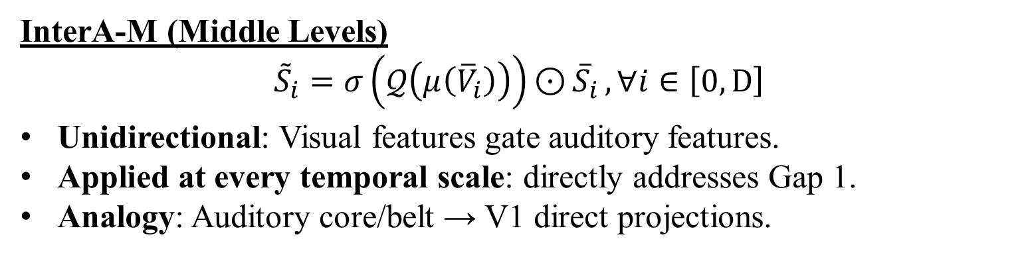
Methodology: InterA-M
InterA-M (Middle Levels)
$${\tilde{S}}_{i}=σ\left(𝒬\left(μ\left({\overline{V}}_{i}\right)\right)\right)⊙{{\overline{S}}_{i}}, ∀i∈\left[0,D\right]$$
Unidirectional: Visual features gate auditory features.
Applied at every temporal scale: directly addresses Gap 1.
Analogy: Auditory core/belt → V1 direct projections.
Caption: Fig. 2(C) Li et al. (2024). InterA-M block diagram.
11/21

Slide 12
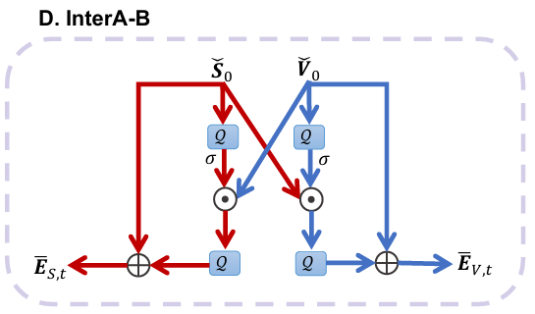
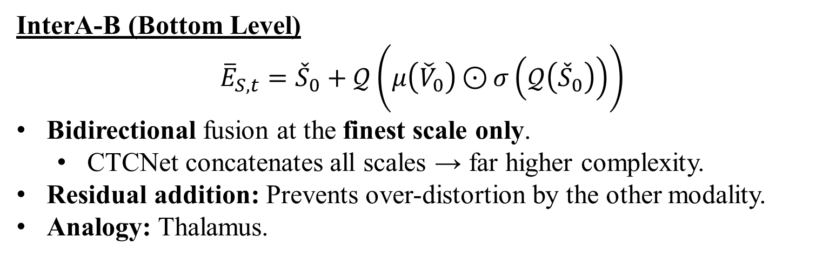
Methodology: InterA-B
InterA-B (Bottom Level)
$${\overline{E}}_{S,t}={\check{S}}_{0}+𝒬\left(μ\left({\check{V}}_{0}\right)⊙{σ}\left(𝒬\left({\check{S}}_{0}\right)\right)\right)$$
Bidirectional fusion at the finest scale only.
  CTCNet concatenates all scales → far higher complexity.
Residual addition: Prevents over-distortion by the other modality.
Analogy: Thalamus.
Caption: Fig. 2(D) Li et al. (2024). InterA-B block diagram.
12/21

Slide 13
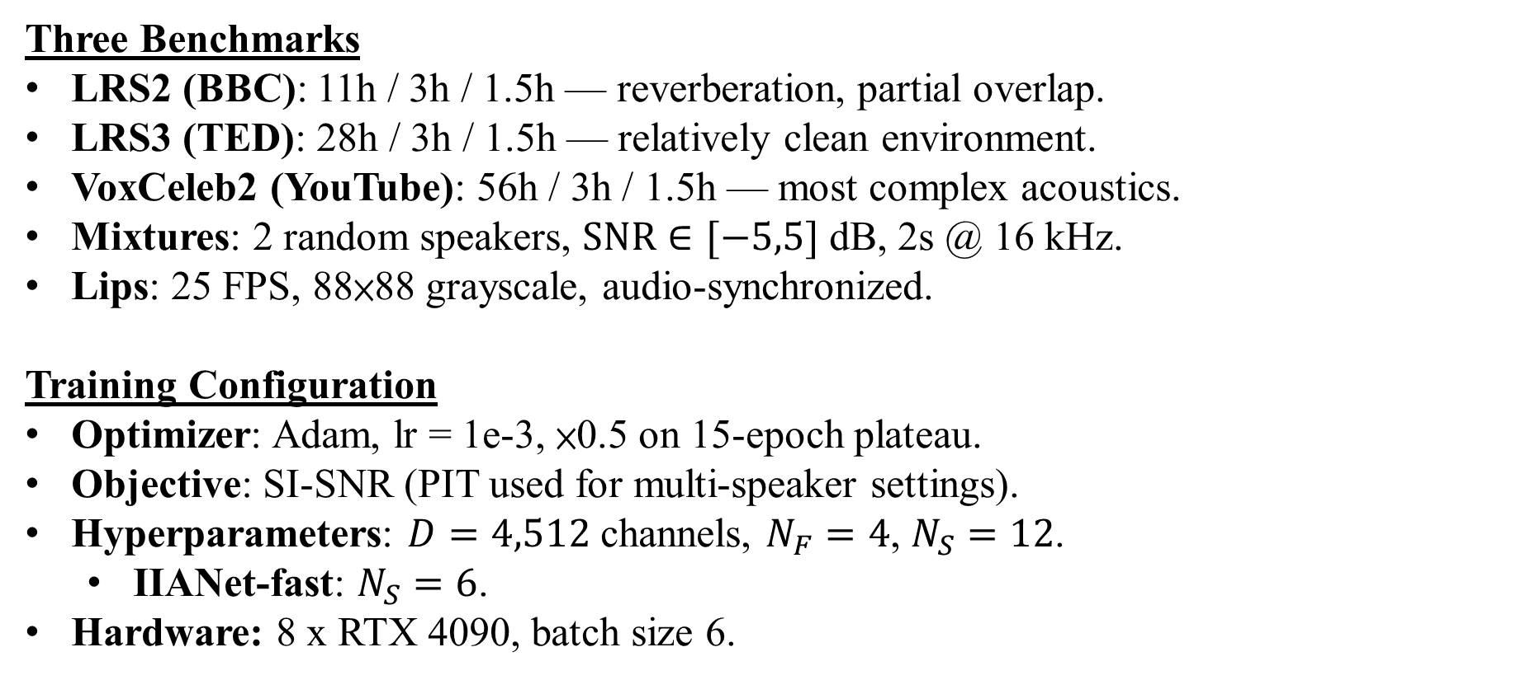
Experiments: Datasets and Setup
Three Benchmarks
LRS2 (BBC): 11h / 3h / 1.5h — reverberation, partial overlap.
LRS3 (TED): 28h / 3h / 1.5h — relatively clean environment.
VoxCeleb2 (YouTube): 56h / 3h / 1.5h — most complex acoustics.
Mixtures: 2 random speakers, $\text{SNR}∈[−5,5]$ dB, 2s @ 16 kHz.
Lips: 25 FPS, 88×88 grayscale, audio-synchronized.
Training Configuration
Optimizer: Adam, lr = 1e-3, ×0.5 on 15-epoch plateau.
Objective: SI-SNR (PIT used for multi-speaker settings).
Hyperparameters: $D=4,512$ channels, $N_{F}=4$, $N_{S}=12$.
  IIANet-fast: $N_{S}=6$.
Hardware: 8 x RTX 4090, batch size 6.
13/21

Slide 14
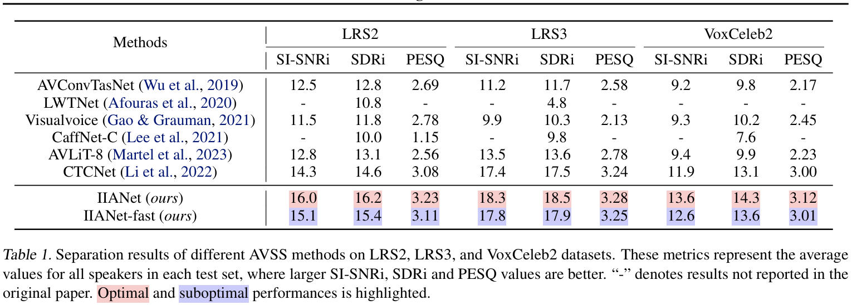
Result: Separation Quality
Consistent SOTA Across Benchmarks
IIANet gains at least +0.9 dB SI-SNRi over all baselines.
Gain reaches +1.7 dB on complex LRS2 and VoxCeleb2.
IIANet-fast still beats CTCNet by +1.1 dB on LRS2.
14/21

Slide 15
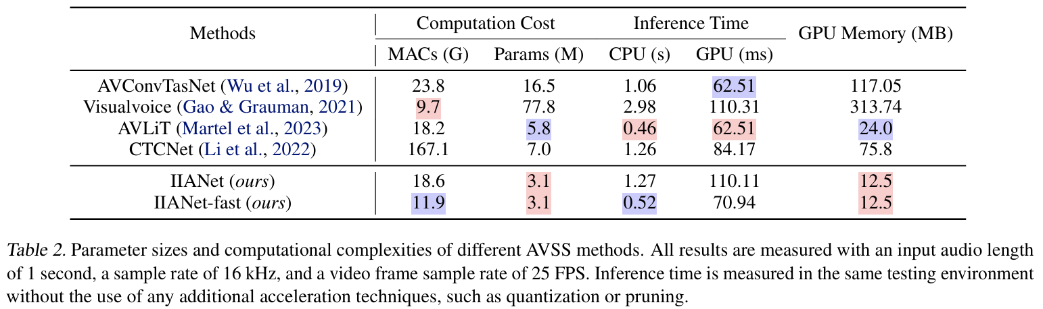
Result: Efficiency Trade-off
Hardware-Agnostic Metrics
vs. CTCNet: 11% MACs, 44% Params, 16% GPU memory.
IIANet-fast: only 7% of CTCNet's MACs.
Real Inference Speed
CPU: 0.52 s vs CTCNet 1.26 s → about 2.4× faster.
GPU: Full IIANet is slower (110 ms vs 84 ms).
  Many small operators → memory-bound, not compute-bound.
Takeaway: Fewer MACs ≠ automatically faster on GPU.
15/21

Slide 16
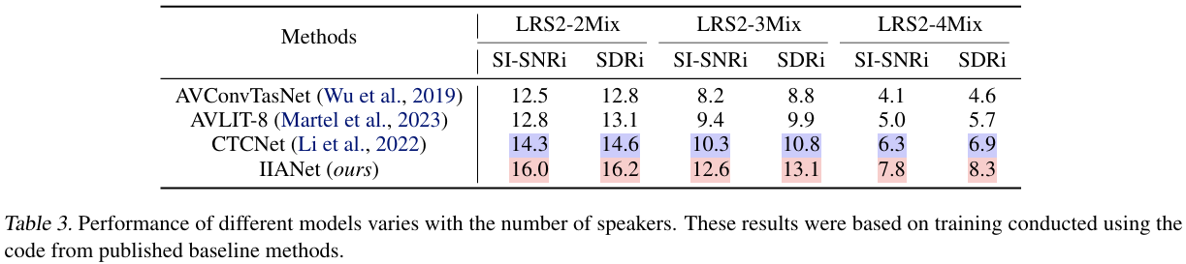
Result: Multi-Speaker Robustness
Scaling to 3 and 4 Speakers
Advantage widens as interference increases (+2.3 dB on 3Mix).
Visual cues become more critical in denser mixtures.
Inference: face detection → lip crop → iterate over each speaker.
16/21

Slide 17
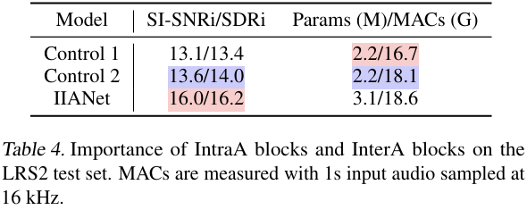
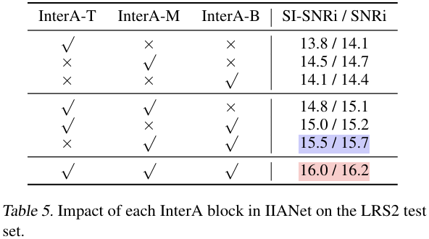
Result: Ablation Study
Component Contribution (Table 4)
Control 1 (no IntraA, no InterA): 13.1 dB.
Control 2 (＋IntraA): 13.6 dB → +0.5 dB.
IIANet (＋InterA): 16.0 dB → +2.4 dB.
  Cross-modal multi-level fusion is the dominant contributor.
InterA Placement (Table 5)
Single block best: InterA-M alone → 14.5 dB.
Pair best: InterA-M ＋ InterA-B → 15.5 dB.
All three: 16.0 dB — the three levels are complementary.
17/21

Slide 18
Result: Additional Analyses
Visual Cue Analyses
Visual Contribution (App. F): 16.0 vs 11.2 dB (audio-only) → ≈ +4.8 dB.
Video Encoder (App. J): DC-TCN / MS-TCN / CTCNet-Lip differ < 0.3 dB.
  Lip-reading accuracy does not correlate with separation quality.
  The fusion strategy matters more than the encoder.
Impaired Cues (App. K): Side-profile degradation.
  AVLiT-8 and CTCNet drop > 8%; IIANet only ≈ 4%.
Training Analyses
Fusion Cycles (App. I): 𝑁𝐹N F​ = 1→5 plateaus at 4 (16.0 dB).
Dynamic Mixing (App. L): LRS2 16.0 → 16.8 dB, only ＋0.1 min/epoch.
Qualitative (App. M): Better high-frequency and harmonic reconstruction.
18/21

Slide 19
Conclusion
Core Contributions
Multi-Level Fusion
  Moves cross-modal fusion from a single point to top / middle / bottom.
Lightweight Selective Attention
  Sigmoid gating replaces similarity-matrix cross-attention.
Efficiency Frontier
  New SOTA with 3.1 M parameters and 11% of CTCNet's MACs.
Future Directions
Long-Form Audio: Current evaluation is limited to 2-second clips.
Deployment Optimization
  Operator fusion needed to convert MACs savings into GPU speed.
Broader Multimodal Tasks
  Audio-visual segmentation, lip-to-speech, cross-modal medical imaging.
19/21

Slide 20
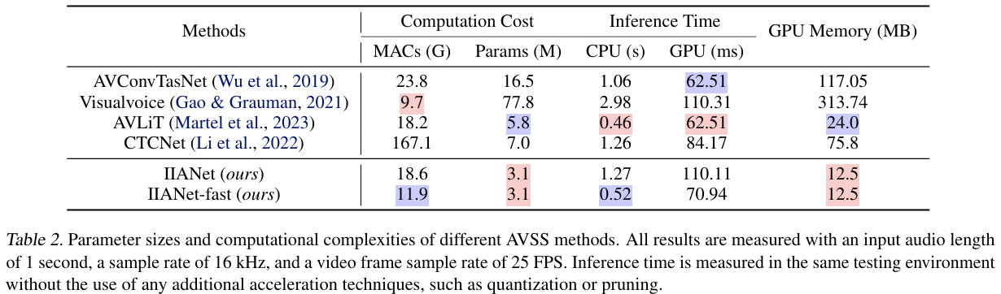
My Insights & Critique
Post-Hoc Brain Analogy
InterA-T/M/B ↔ frontal cortex / cortical projections / thalamus.
  No neural validation experiment; mapping is an analogy, not evidence.
  Stripped of the narrative, the method is multi-scale gated fusion.
Reporting Inconsistency
Abstract claims "40% faster"; Introduction claims "more than twice".
  Table 2 supports ≈ 2.4× — trust the table, not the abstract.
20/21

Slide 21
My Insights & Critique
Design Asymmetry
InterA-T and InterA-B are bidirectional, InterA-M is visual → audio only.
No ablation justifies removing the audio → visual path at middle levels.
Transferable Value
Gated multi-scale fusion is cheap enough for 3D medical volumes.
  Directly applicable to CT/MRI synthesis and multi-sequence segmentation.
Replacing sigmoid gating with SSM / Mamba is a natural extension.
  Authors already cite an SSM-based AOSS model (Chen et al., 2023).
21/21

